Slide 1
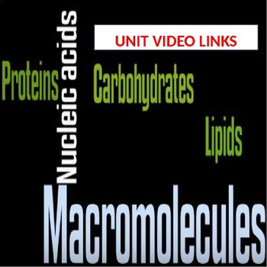
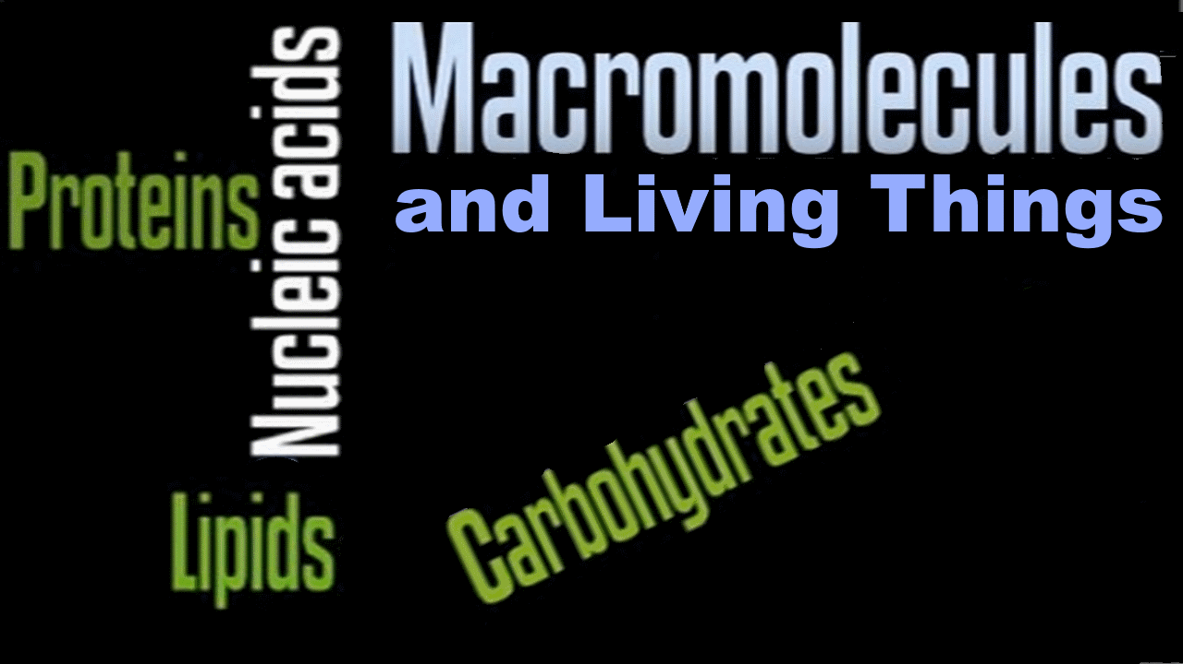

Slide 2
Bioelements
Elements in human body may be:
Essential elements: essential element is the one whose deficiency consistently causes abnormal
development or functioning and the absence of it results in death. These are divide
into:
A) Bulk elements: The building blocks of the compounds that constitute our organs and muscles, such as:
Oxygen(O), Carbon(C), Hydrogen(H), Nitrogen(N), Sulfur(S).
B) Macrominerals: They provide essential ions in body fluids and form the major structural components of the
body including : Sodium (Na), Magnesium (Mg), Potassium (K), Calcium (Ca), Chlorine
(Cl), and Phosphorus (P).
C) Trace element: Present in very small amounts, but are not required for growth or good health. Such as:
Cobalt (Co), Copper (Cu), Fluorine (F), Iodine (I), Iron (Fe), Manganese (Mn),
Molybdenum (Mo),

Slide 3
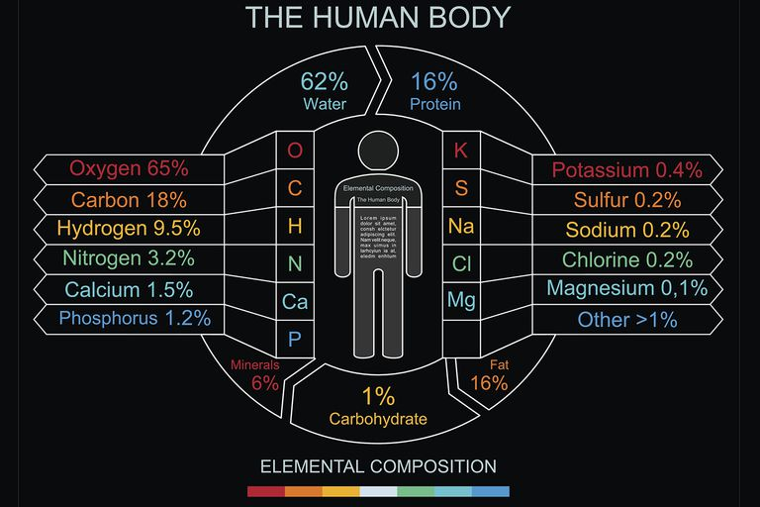
Percentage of some elements in human body

Slide 4
Macromolecules
The most common elements combine and form thousands of molecules. Some of these are:
Small molecules: Such as water (H2O)
Organic compounds: Four major categories are found in all living things, these divide into:
Macromolecules: Called polymers because they are made up from repeated subunit
(monomer). This type includes:
Carbohydrates, Proteins, and Nucleic acids.
Lipids : Large molecules, but not polymer.

Slide 5
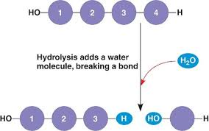
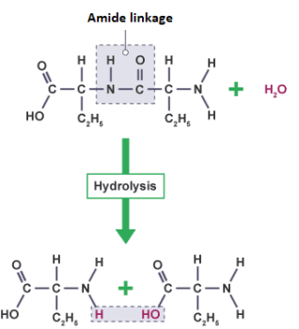
Hydrolysis
Hydrolysis reactions result in the breakdown of polymers into monomers, this reaction:
Speed up by specific enzyme
Break chemical bonds
Release energy
The following schemes show the hydrolysis reaction:

Slide 6
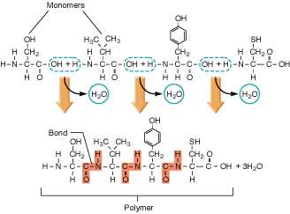
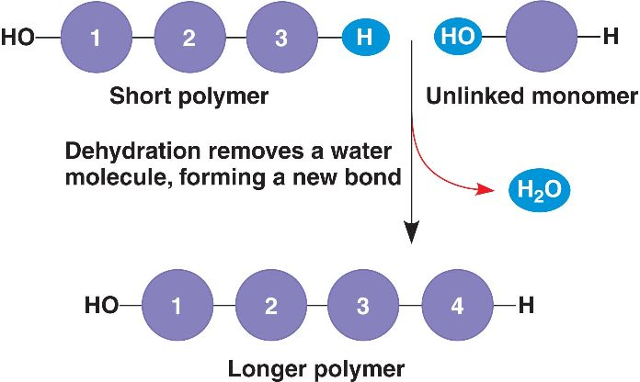
Dehydration (Condensation)
In dehydration synthesis reactions, a water molecule is formed as a result of generating a covalent bond between two monomeric components in a larger polymer.
Speed up by specific enzymes
Formation of new bonds
Requiring energy
Scheme of Dehydration

Slide 7
Macromolecules
Carbohydrate:
Functions in energy storage (starch and glycogen) and structural
support and protection (cellulose and chitin).
Organic compounds that contains Carbon(C), Hydrogen(H), Oxygen(O)
Carbohydrates represented by the formula (CH2O)n, where n is the number of carbon atoms in the molecule. In other words, the ratio of C:H:O is 1:2:1 in carbohydrate molecules.

Slide 8
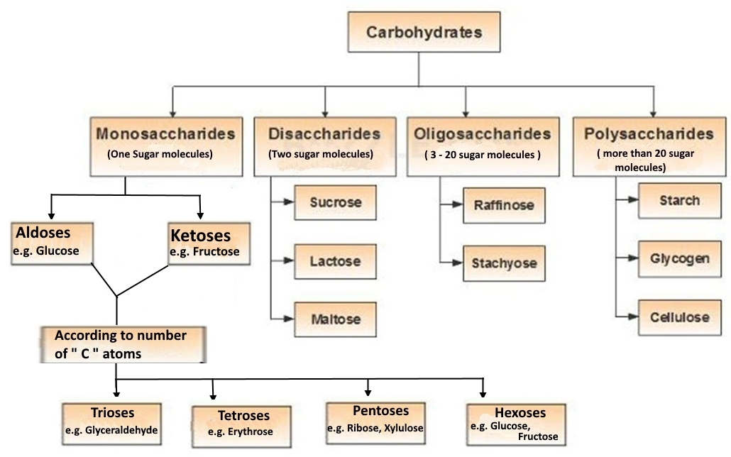
CLASSIFICATION OF CARBOHYDRAYES
Carbohydrates are classified into four subtypes, these are:

Slide 9
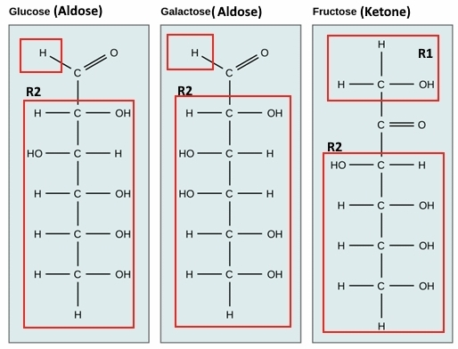
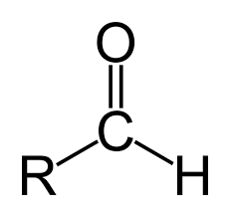
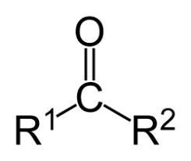
Monosaccharides:
1- The simplest sugar.
2- They are either:
Aldoses ( ) such as Glucose,
or Ketoses ( ) such as Fructose.
3- Isomers: one or more compound that
have the same chemical formula
but differ structurally and
chemically such as Glucose,
Galactose, and Fructose. All of
have formula (C6H12O6) but
as in behind picture.

Slide 10
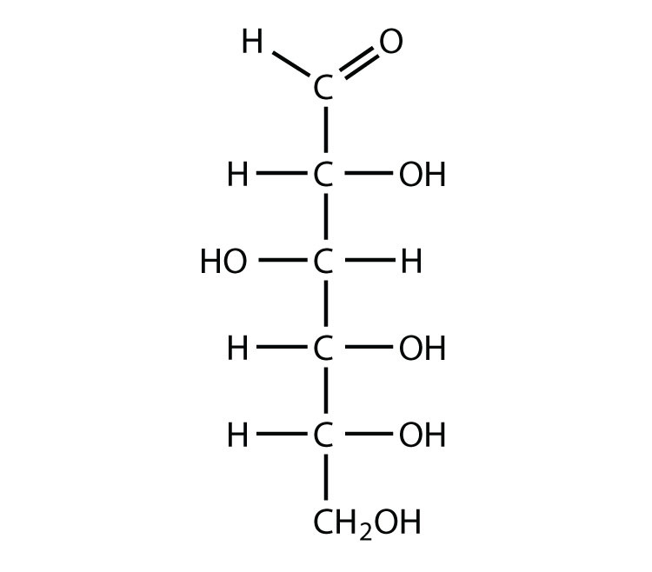
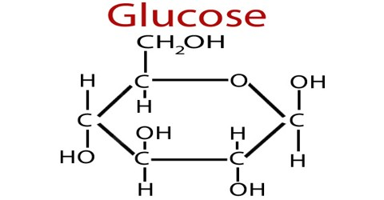
Monosaccharides:
4- The number of carbon atoms usually ranges from three to six, Trioses (3
carbon atoms), Pentoses (5 carbon atoms), Hexoses(6 carbon atoms).
5- May exist as a linear chain or as ring-shaped molecules; in aqueous solutions,
they are usually found in the ring form.
6- All of them are reducing sugar. They have free aldehyde group or can
tautomerize in solution to form aldehyde group if they are ketoses, as
Fructose, ribose, and Xylose.

Slide 11
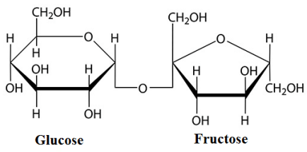
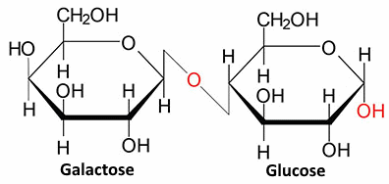
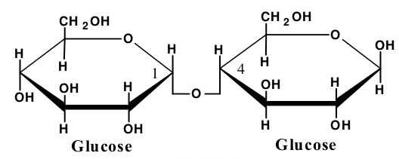
Disaccharides:
Made up from two monomers bind together by glycoside bond, as:
Sucrose
Lactose
Maltose

Slide 12
Benedict’s test for reducing sugar:
Reducing sugars:
Sugar classified as reducing agent if:
- It can act as a reducing agent.
- It has open-chain form with free aldehyde or ketone group
All monosaccharides are reducing sugars because all of them have open-chain form with free
aldehyde or ketone group that tautomerize in solution to form aldehyde group.
e.g. Glucose, Galactose, Fructose, Ribose, and Xylose.
Disaccharides
Reducing sugars: Can convert to open-chain form with free aldehyde group, because only one
of their two anomeric carbon involve in the glycoside bond.
e.g. Lactose and Maltose

Slide 13
Non-reducing sugars: Can’t convert to open-chain form with free aldehyde group,
because the two anomeric carbon involve in the glycoside bond.
e.g. Sucrose and Trehalose
Some Oligosaccharides and Polysaccharides are reducing sugar, the others are Non.
Benedict’s reagent: is an aqueous solution of copper(II) sulfate, Sodium carbonate, and sodium
citrate.
The principle:
Aldehyde group of the sugar oxidized and the copper (II) in solution reduced via the
Redox reaction, then copper (I) oxide (Cu2O) precipitate is formed.
The color of the precipitate may be Green (the lowest), Yellow, Orange, and dark red ( the
highest) depending on the amount of precipitate which in turn depends on the
amount of reducing sugar.

Slide 14
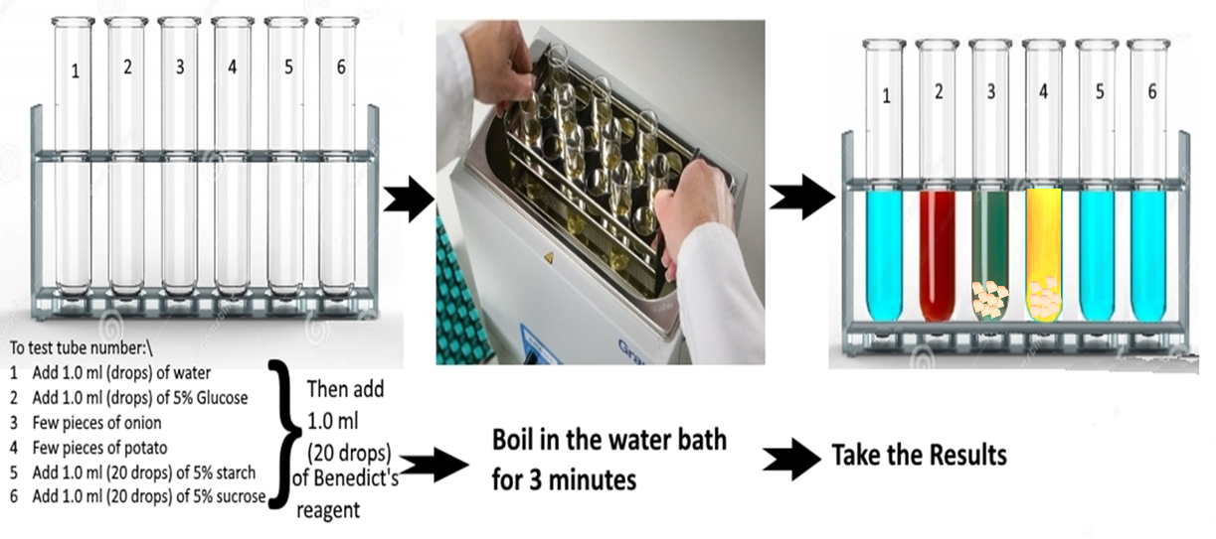
Identification of carbohydrates:
Experiment 1: Benedict’s test
Experiment 1: The practical part of Benedict’s test for reducing sugar:

Slide 15
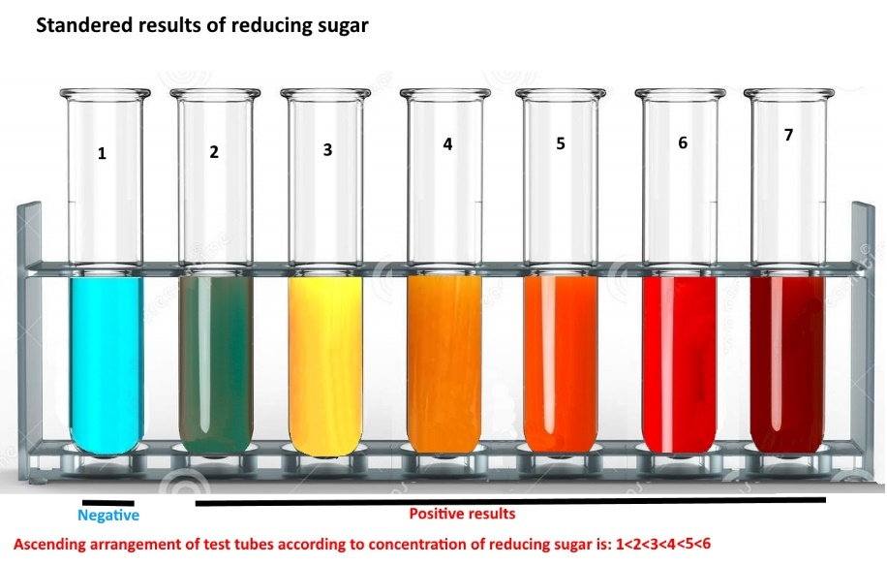

Slide 16
Identification of carbohydrates:
Lugol’s test:
Used to identify the starch.
Lugol’s solation consists Iodine in aqueous solution of potassium iodide.
The principle: Iodine react with starch to form polyiodide that result in the formation of a deep blue-black color.
The amylose (straight portion of starch causes the dark blue black color, while
the amylopectin (branched portion of the starch forms orange/yellow color

Slide 17
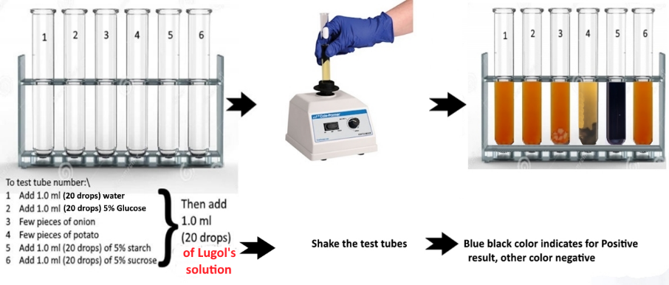
Experiment 2: The practical part of Lugol’s test for starch:

Slide 18
lipids
Lipids:
Function in energy storage and have structural purposes in living things.
They are neither huge nor polymer
They are hydrophobic (hate water)
They are three types:
Fats: Made from Glycerol + 3 fatty acids
Glycerol: Alcohol with three carbons, each one bears hydroxyl group (- OH).
Fatty acids:
Usually 16 or 18 carbon atoms in length
Consists carboxyl group (-COOH) as functional group.
Makes the Fats Hydrophobic.

Slide 19
lipids
Some fatty acids contains one or more double bonds that cause
kinks or bends in the carbon chain (unsaturated fatty acid). Others
have no double bond (saturated fatty acid). The saturated fatty
acid contains the highest number of hydrogen atoms.
The carboxyl group of each fatty acid molecules will bind to one of the
hydroxyl group of glycerol through dehydration reaction to form ester bond.
Fats either:
Saturated: if the three fatty acid molecules are saturated.
Unsaturated: if at least one of the three fatty acid molecules is
saturated.

Slide 20
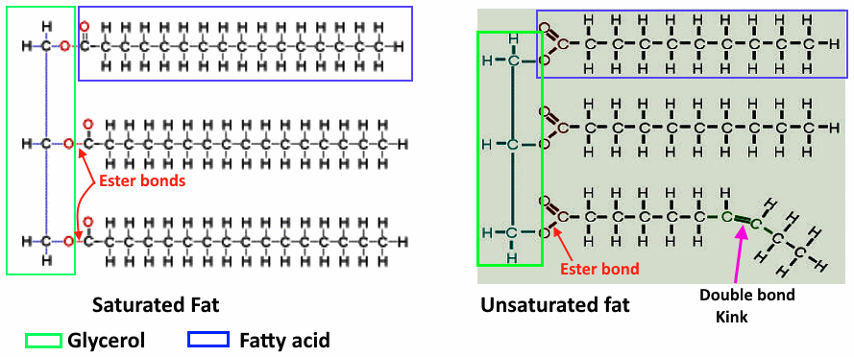
lipids

Slide 21
lipids
Phospholipids:
Major components of cell membranes.
Amphipathic molecules: with hydrophobic tail and hydrophilic head.
Made up from:
Glycerol molecules
Two fatty acid molecules, each one attached to one carbon of glycerol. The two fatty
molecules form the hydrophilic tail of the phospholipid.
The third carbon of the glycerol attached to the phosphate group and choline forming
the hydrophobic head of the phospholipid.

Slide 22
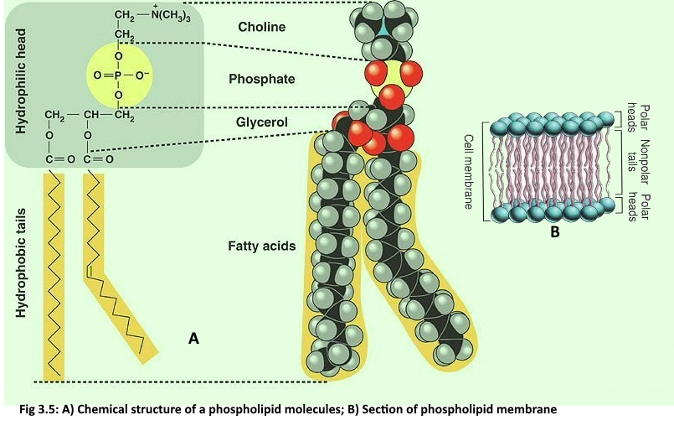
Phospholipids:

Slide 23
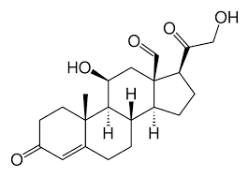
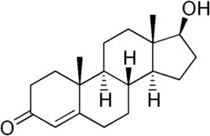
Steroids:
Functions:
Alter membrane fluidity (Cholesterol)
Acts as signaling molecules which activate steroid hormone receptors.
Composed of seventeen carbon atoms, bonded in four "fused" rings.
Steroids vary by the functional groups attached to this four-ring core and by the
oxidation state of the rings.

Slide 24
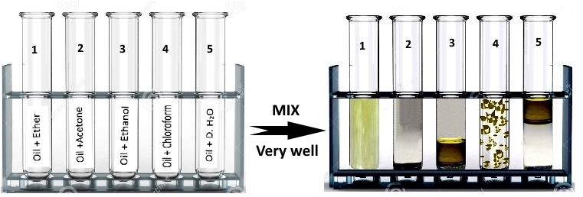
Experiment 3: Solubility test of fats and lipids:

Slide 25
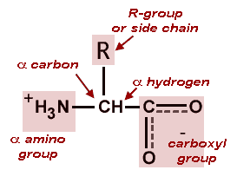
Proteins
Proteins:
They act as structural components (i.e. in hair, muscles, skin, and other tissues.
Most of the enzymes in the living organisms are proteins that catalyst the speed
up of biological reactions.
They are polymer of amino acids (monomers).
Diversity of protein results from differing in arrangement of 20 amino acid.
All amino acids have central carbon (alpha carbon) bind to Carboxyl group (-COOH),
Amino group (-NH2), Hydrogen (H), and side Chain.

Slide 26
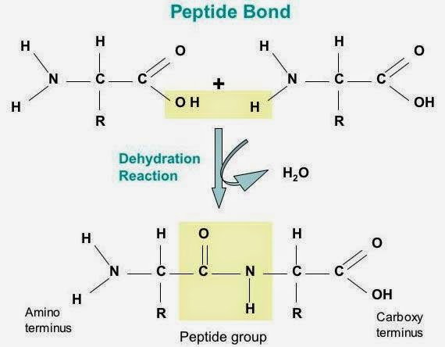
Proteins
Amino acids differ only in the side chain (R).
(-COOH) of the first amino acid reacts with (-NH2) of the second to form peptide bond through a dehydration reaction (remove water molecule) as the following:

Slide 27
Experiment 4: Biuret test to reveal the presence of peptide bonds:
The Biuret reagent is made of sodium hydroxide (NaOH) and hydrated copper(II) sulfate,
together with potassium sodium tartrate.
Sodium hydroxide: Provide alkaline condition.
Potassium sodium tartrate: Stabilize the chelate complex.
Principles:
The reaction of the cupric ions with unshared electron pairs of the nitrogen
atoms involved in peptide bonds leads to the displacement of the peptide
hydrogen atoms under the alkaline conditions, this result in the formation of
Chelate complex.
Chelate complex absorb the light at 540 nm and hence appears violet.
The color changes from blue to pink if the concentration of peptide bonds is
low like in short-chain.

Slide 28
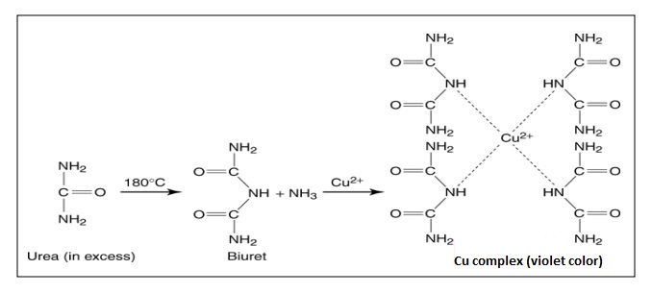
The color changes from blue to Violet if the concentration of peptide bonds is
high like in proteins.

Slide 29
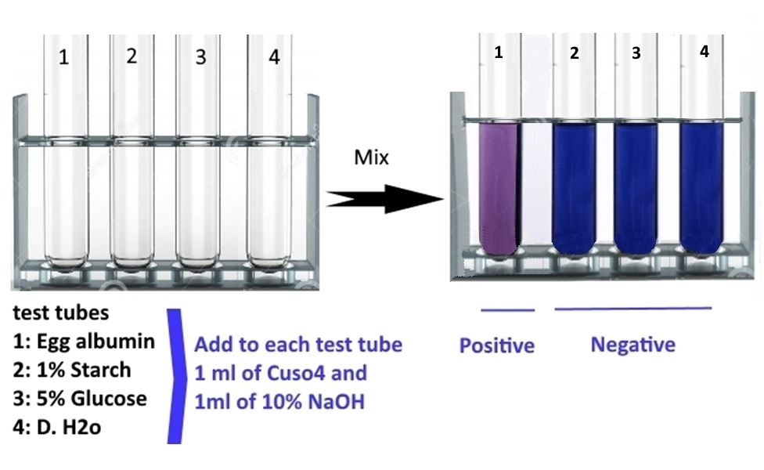
Practical :

Slide 30
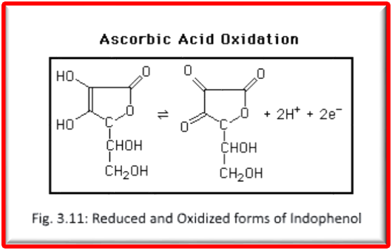
Vitamin C
Vitamin C (Ascorbic Acid):
- Helps the body in forming connective tissue, bone, teeth, …… etc.
- Assists the body in assimilating iron and amino acids.
- Vitamin C is also an anti-oxidant, The foods that contain large amount of Vitamin C,
such as oranges, lemons, and limes, will not turn brown.
- The chemical instability of vitamin C acid is due to the fact that it is a strong
reducing agent

Slide 31
Experiment 5: Test of Vitamin C in different juices:
- Studies the concentration of vitamin C in Lemon, Grape, and Orange juices by redox
titration.
Indophenol blue in color if the (pH >4), and colorless if the (pH <4).
Ascorbic acid lower the pH, and bleach the color of Indophenol .

Slide 32
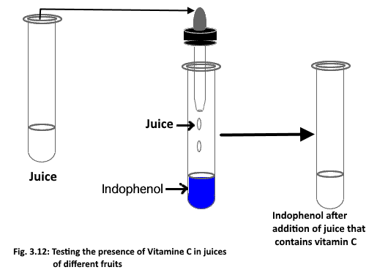
The procedure:
1. Add 1 ml of 1% indophenol (about 18 drops) in a cleaned test tube.
2- By a dropper, add juice drop by drop with shaking after each addition.
3- Continue adding the juice until the indophenol became colorless (the color of original juice you added)
4- Count How many drops you need from the juice to convert the indophenol to colorless.
5- Repeat step 1 – 5 using other juice
Note: the concentration of the vitamin C in the juice is inversely proportional with the number of juice drops needed to make the color of indophenol to disappear.

Slide 33
Take care about the followings:
Don’t use cracked test tubes.
Read the label and the directions on the bottle before use it
Prevent the cross contamination by use a separate pipette for each solution
Take care when you use the Boiling water bath.
Don’t retain the excess solution to the bottle
Follow the direction of the instructor in disposing the chemicals

